Slide 1
Dynamic Arrays/Vector ADT

Slide 2
Recall Disadvantages With Array
Fixed Size:
Once declared, an array's size cannot be changed dynamically. This means you need to know the exact number of elements you'll need beforehand, which can be limiting if your data is flexible or unknown.
If you allocate more space than needed, you waste memory. If you allocate too little, you'll need to create a new array and copy all the elements, leading to performance overhead.

Slide 3
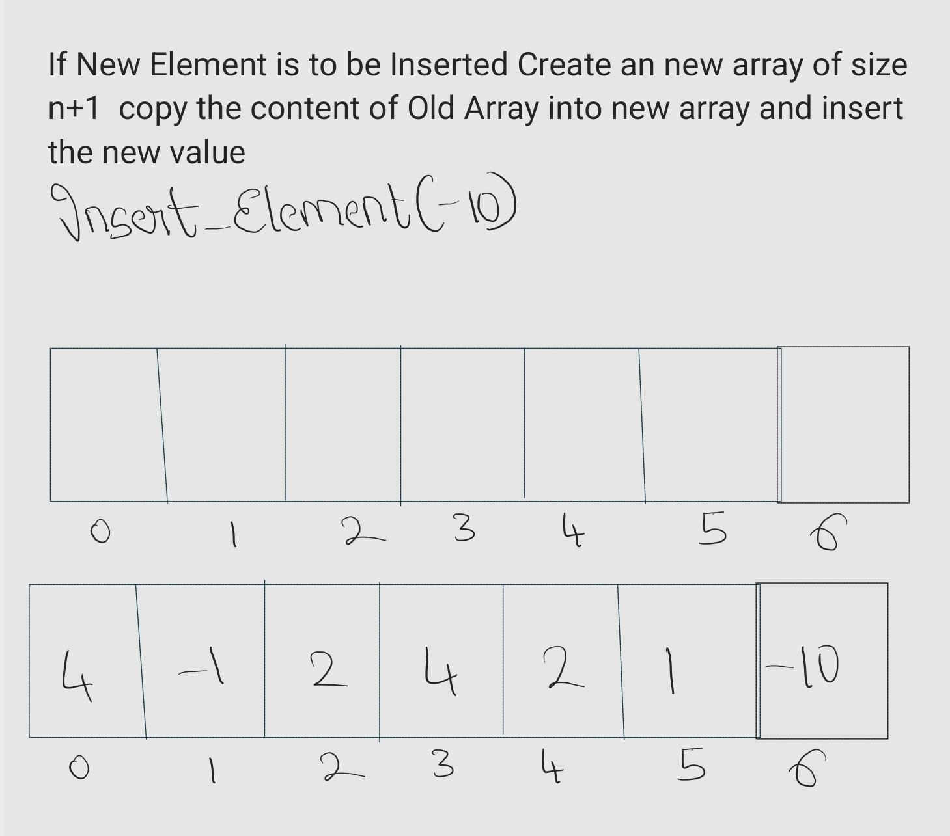
Growing In Static Array

Slide 4
Dynamic Array/Vector
A dynamic array is a data structure that allows for the efficient storage and retrieval of elements, similar to an array. However, unlike a static array whose size is fixed at the time of declaration, a dynamic array can dynamically resize itself during runtime to accommodate a varying number of elements.

Slide 5
Vector Operations
Operation | Description
Default constructor (create empty) | Create empty vector
Size() | Return number of elements in vector
Get(i) | Return element at index i
Set(i, x) | Assign element at index i
PushBack(x) | Add x to the back of the vector (highest index)
PopBack() | Remove the last element (highest index)

Slide 6
Push Back Or Insert Operation
Insert_Element(value):
If(size<Capacity):
Arr[size]=value
Else:
Resize_Array()//A Function To Increase The Capacity of Array
Arr[size]=value

Slide 7
Resizing Strategy
Initially Let's Assume We Start with A Array of Capacity
When(Size==Capacity) i.e When Array Is Full
We Create a New Array with Capacity Twice the Previous One
Capacity=Capacity*2

Slide 8
Time Complexity Of Resizing Array
We Need to Create a New Array of Capacity*2—O(1)
Copy The Elements from the Old Array to New array---- O(n)
Total Time Complexity is O(n)

Slide 9






Resize After 1 Insert
Resize After 2 Inserts
Resize After 4 Inserts
Resize After 8 Inserts
Resize After 16 Inserts
Resize After 32 Inserts
So 1, 2, 4, 8, 16, 32, 64, … 2^n

Slide 10
Example: PushBack
size = 0 capacity = 1 array
?

Slide 11
Example: PushBack
size = 1 capacity = 1 array
Added: 7
7

Slide 12
Example: PushBack
size = 2 capacity = 2 array
Added: 7, 3
7
?

Slide 13
Example: PushBack
size = 2 capacity = 2 array
Added: 7, 3
7
3

Slide 14
Example: PushBack
size = 2 capacity = 2 array
Added: 7, 3, 4
7
3

Slide 15
Example: PushBack
size = 2 capacity = 4 array
Added: 7, 3, 4
7
3
?
?

Slide 16
Example: PushBack
size = 3 capacity = 4 array
Added: 7, 3, 4
7
3
4
?

Slide 17
Example: PushBack
size = 3 capacity = 4 array
Added: 7, 3, 4, 8
7
3
4
?

Slide 18
Example: PushBack
size = 4 capacity = 4 array
Added: 7, 3, 4, 8
7
3
4
8

Slide 19
Example: PushBack
size = 4 capacity = 4 array
Added: 7, 3, 4, 8, 5
7
3
4
8

Slide 20
Example: PushBack
size = 4 capacity = 8 array
Added: 7, 3, 4, 8, 5
7
3
4
8
?
?
?
?

Slide 21
Example: PushBack
size = 5 capacity = 8 array
Added: 7, 3, 4, 8, 5
7
3
4
8
5
?
?
?

Slide 22
Worst Case Time Complexity??
Recall: worst-case time means the maximum time of an operation (slowest)
Usually a fair measure
But can be unfair on
Repeated operations
Almost all operations are fast
But rare operations are slow
Worst-case analysis would focus on the “rare operations are slow”

Slide 23
Amortized Time Complexity
In computer science, amortized time complexity is a method for analyzing the average cost of an operation in a sequence of operations, rather than the worst-case cost of individual operations. Here's a breakdown of the key points:
Motivation:
Sometimes, focusing solely on the worst-case time complexity of an operation can be misleading, especially when some expensive operations happen infrequently.
Amortized analysis provides a more nuanced understanding of performance by considering the average cost over a sequence of operations.

Slide 24

Given a sequence of operations T1, T2, ..., Tk on a data structure, the amortized time complexity of a single operation is:

Slide 25
Analogy: Buying Soda
Repeated operation: if out of soda, buy a 12-pack for $4; then drink 1 soda
Starting from nothing, this operation costs:
$4, $0, $0, $0, $0, $0, $0, $0, $0, $0, $0, $0, $4, $0, …
Pattern: one $4, eleven $0, repeats…
Worst-case cost: $4
Unfair to say each soda costs $4
Amortized cost is unit price
package price ÷ units in package
= $4 ÷ 12 = $0.33 per drink

Slide 26
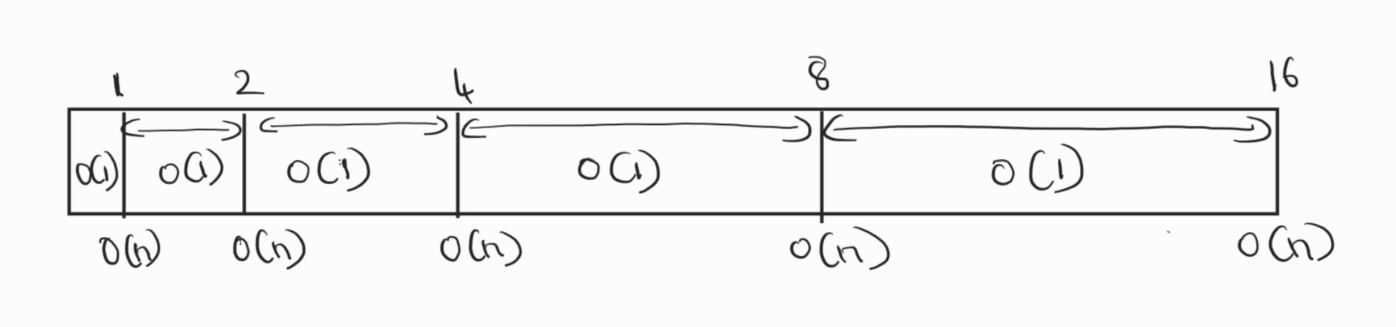
Relating it To Inserting Element
Cost Of Inserting O(1)
Cost Of Resizing is O(n)
But How Often We Resize? For Every 2n Operations
If Observed The Frequency of Resizing Decreases as n increases
1,2,4,8,16,32,64,128,256.....................
So What is The Time Complexity?

Slide 27
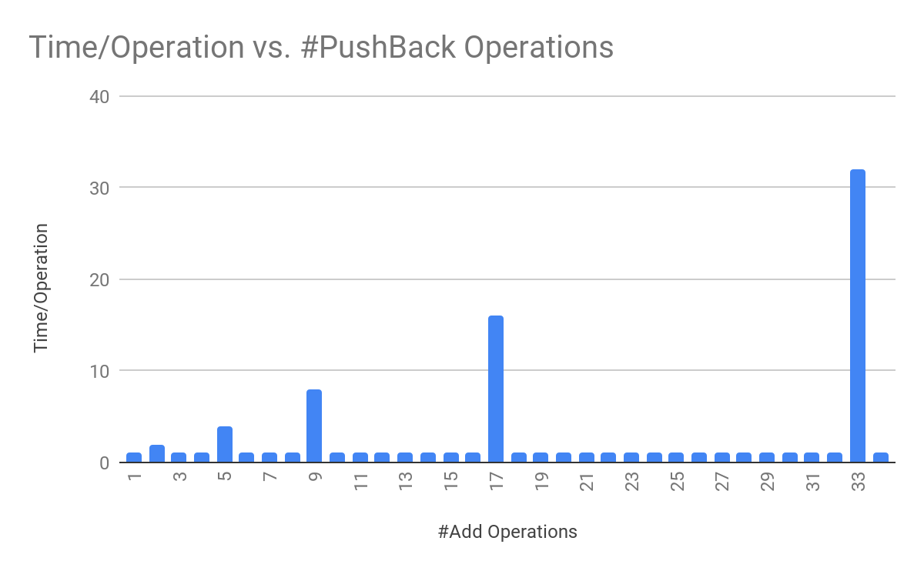

Slide 28
PushBack Amortized Time
Claim: A sequence of O(n) PushBack operations spends O(n) total time in Resize.
Let n = size immediately after a Resize
At that moment, capacity = 2n
The next n PushBack operations do not overflow; O(1) time each
The (n+1)^{th} PushBack does overflow and resize; O(n) time
So (n+1) PushBacks; n ✕ O(1) + O(n) = O(n) total time
O(n) PushBacks take O(n) total time, so one PushBack takes O(1) amortized time
O(1) amortized time

